Slide 1

Remote Smart Internship Program
Project ID : SPS_PRO_101
~by C.kailash

Slide 2
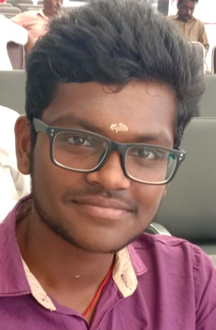
Personal Details:
Name: C. Kailash.
Post: I- year B.Sc.IT (Data Science).
Institution: Rathinam College of Arts and Science, Coimbatore.
Location: Pollachi, Coimbatore, Tamil Nadu-642006.
D.O.B: 05.04.2002
Phone : 8838808840
E-mail: kailash5402.datascience@gmail.com

Slide 3
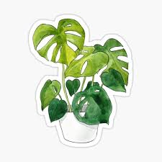
Smart Agriculture based on Internet of Things.
Smart Agriculture System based on IOT can monitor soil moisture and climatic conditions to grow and yield a good crop.
Farmer is provided a mobile app using which he can monitor the temperature, humidity and soil moisture parameters along with weather forecasting details.
Based on all the parameters he can water his crop by controlling the motors using the mobile application.
Even if the farmer is not present near his crop he can water his crop by controlling the motors fitted with a timer using the mobile application from anywhere.

Slide 4
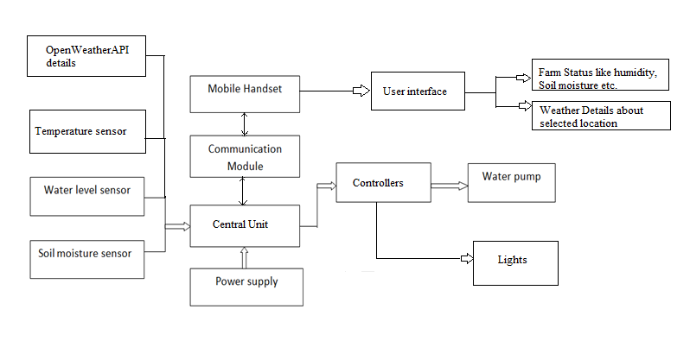
Block diagram:

Slide 5
Future Scope:
IoT sensors are capable of providing farmers with information about crop yields, rainfall, pest infestation, and soil nutrition are invaluable to production and offer precise data which can be used to improve farming techniques over time.
With a future of efficient, data-driven, highly-precise farming methods, it is definitely safe to call this type of farming smart. We can expect IOT will forever change the way we grow food.
IoT sensors can be fitted with drones and fitted with pesticide or fertilizer spray which allows quick area coverage and less wastage of resource.
In Cattle farming sensors can be fitted to the animals to check their body temperature, Blood pressure etc.

Slide 6
Conclusion:
The main purpose of the project ,that is live monitoring and control of farm and irrigation is met.
Thanks!

